Slide 1


CFPB’s consumer
complaint database
Analysis reveals valuable insights
Yuecheng Zhang, Xixiang Chen, Xinyu Su,
Zihan Zhao, Guanting Gai
Apr.4th 2020

Slide 2
CONTENT
01.
Overview:
Data Visualization and Observation
02.
Specific Suggestions
03.
Q&A
04.

Slide 3
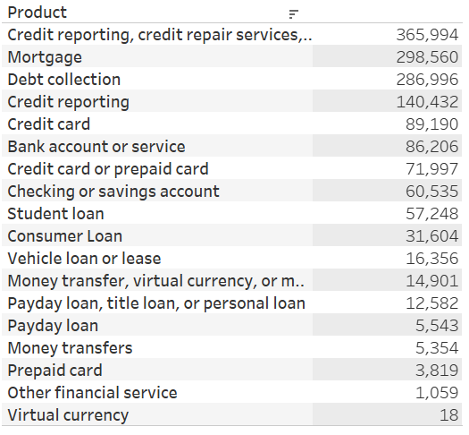
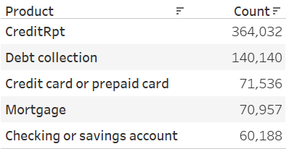
Overview
Data Description:
Dataset with 1,548,394 rows and 18 columns
18 products (repeated), 77 sub-products
issues, sub-issues, company, etc.
Data Clean:
Combine and re-organize by Product
9 products
Time range from 04/2017 to 03/2020

Slide 4
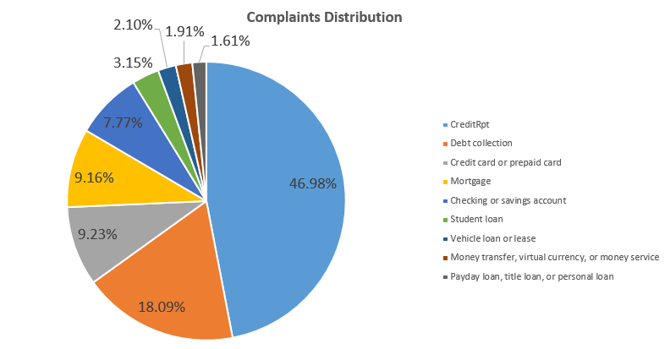
Data Visualization and Observation

Slide 5
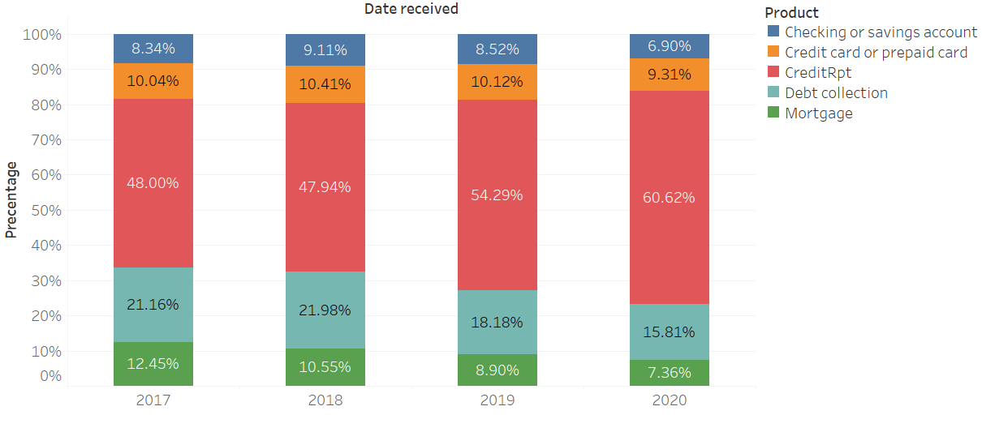
Data Visualization and Observation
Top 5 Products

Slide 6
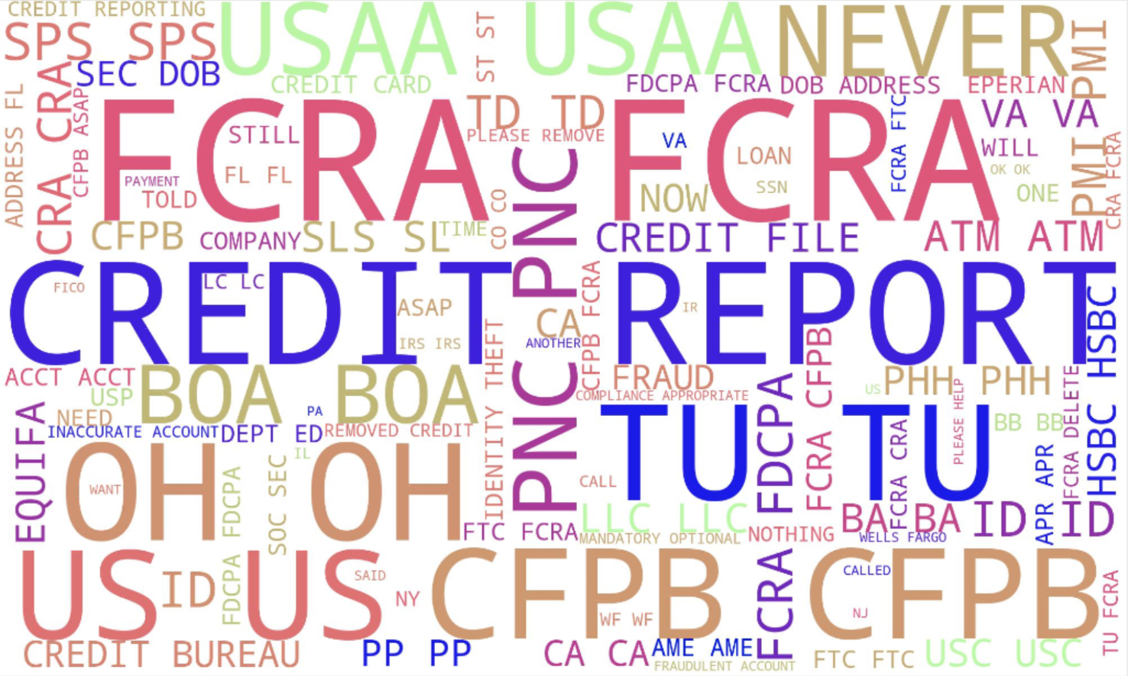
Data Visualization and Observation
Word Cloud

Slide 7
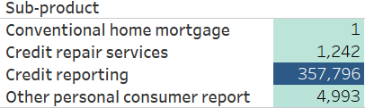
Data Visualization and Observation
Sub-product:
Almost all sub-products in creditRpt are credit reporting

Slide 8
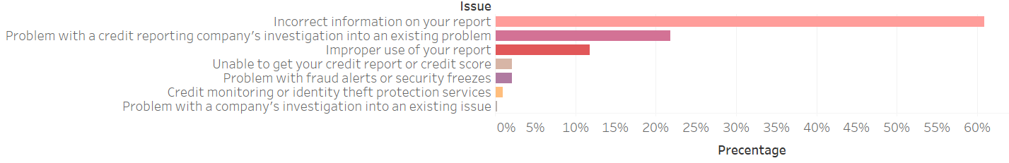
Data Visualization and Observation
Issues:
Incorrect information on your report
Problem with a credit company’s investigation into an existing problem

Slide 9
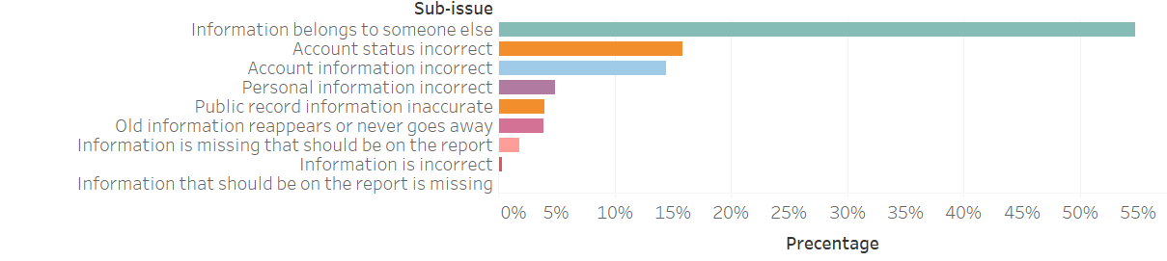
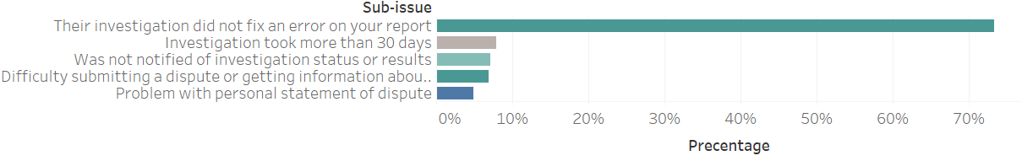
Data Visualization and Observation
Sub-issues of incorrect information on your report
Problem 1: Poor information process lead to wrong record and privacy disclosure
Problem 2: Inadequate management on database maintenance
Sub-issues of Problem with a credit company’s investigation into an existing problem

Slide 10
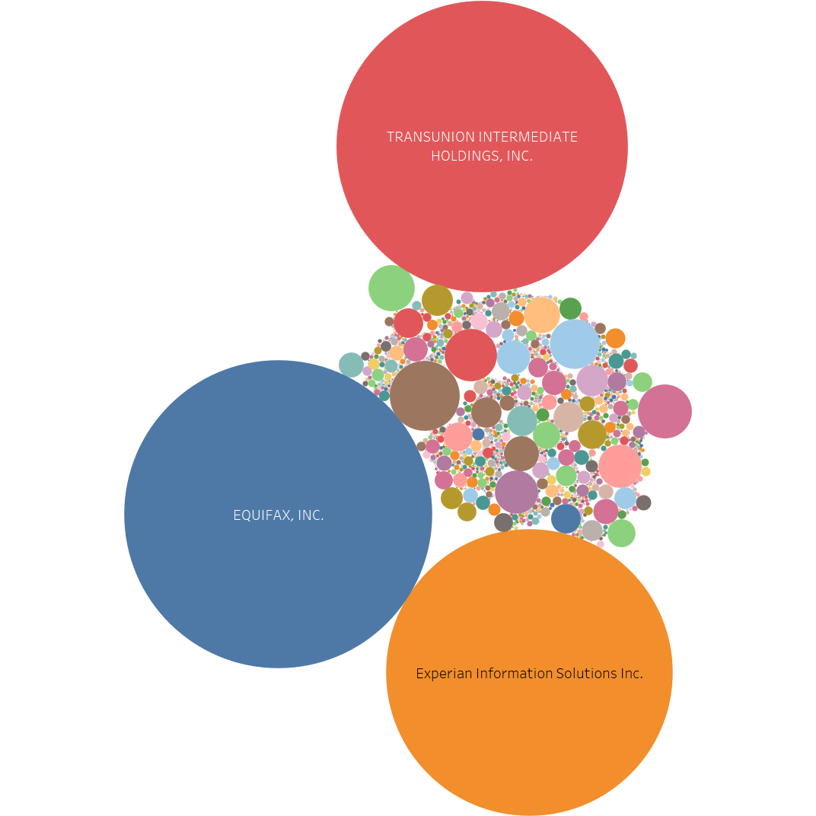
Data Visualization and Observation
Company:
Equifax, Inc.
TransUnion intermediate holdings, Inc.
Experian information solutions, Inc.

Slide 11
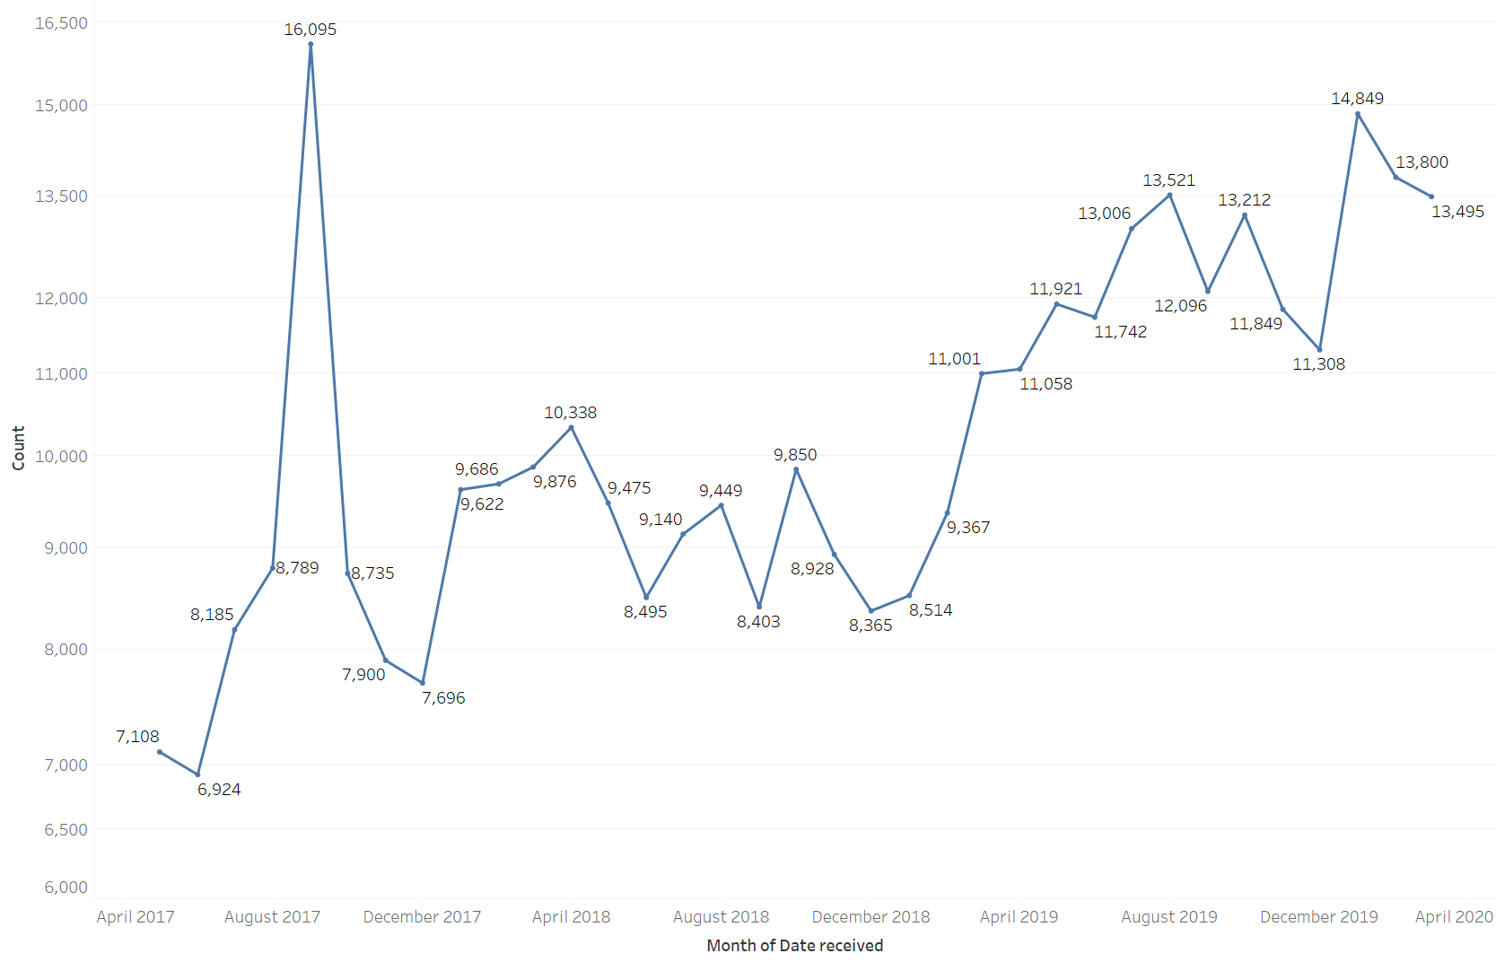
Data Visualization and Observation
Problem 3: The CFPB's rules shield the company from class-action lawsuits in the event of an accident such as a data breach

Slide 12
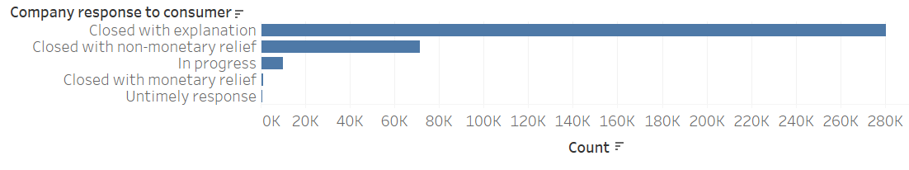
Data Visualization and Observation
Company’s response to Consumers;
different response to consumers:
in favor of consumers(monetary or non-monetary relief)
not in favor of consumers(closed with explanation)
more complaints that are not solved in consumers’ favor means complaints may be the result of customer misunderstanding rather than actual mistakes or operational errors by companies
Problem 4: Customer misunderstanding may create more complaints than firms’ error

Slide 13
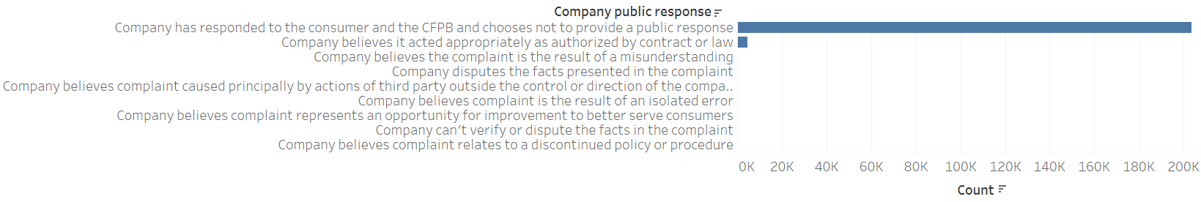
Data Visualization and Observation
Company Public Response:
Company has responded to the consumer and the CFPB and chooses not to provide a public response
Problem 5: In order to shape its image in the marketplace, a firm may not submit all complaints to CFPB, so the database can’t fully reflects a firm's complaint records.

Slide 14
Specific Suggestions
5 Problems:
Poor information process
Inadequate database management
Unfair CFPB's rules
Communication problem
Data transparency problem
Notes:
Poor information process lead to wrong record and privacy disclosure
Inadequate management on database maintenance
The CFPB's rules shield the company from class-action lawsuits in the event of an accident such as a data breach
Customer misunderstanding may create more complaints than companies’ error
Consumer Complaint Database only includes complaints submitted to the CFPB, it is unlikely that the database fully reflects a financial institution's own complaint records.

Slide 15
Specific Suggestions
Poor information process
Establish a regulatory system and set up indicators and punishment for the company’s information system
Inadequate database management
Rule the database management frequency and maintenance standard
Unfair CFPB's rules
Amend or repeal the CFPB's special protections that shield companies from class-action lawsuits
Communication problem
Firms must fully explain the unclear in the contract and on the websites to consumers
Data transparency problem
Government should consider monitoring firms’ CFPB data and make sure that data is complete and transparent.
Notes:
For example: if the number of monthly complaint of information errors exceed the indicators, the company will be subject to additional taxes
Legislation sets a minimum time interval for a company to maintain a database
Amend or repeal the CFPB's special protections that shield companies such as Equifax from class-action lawsuits
Better communication with customers may help firms manage consumer expectations as well as reduce complaints. Firms must fully explain the unclear in the contract to consumers
Government should consider monitoring firms’ CFPB data and make sure that data is complete and transparent.

Slide 16
Q&A
QUESTION?

Slide 17
THANKS FOR LISTENING
Apr.4th 2020

